Slide 1
Chapter 3: Processes

Slide 2
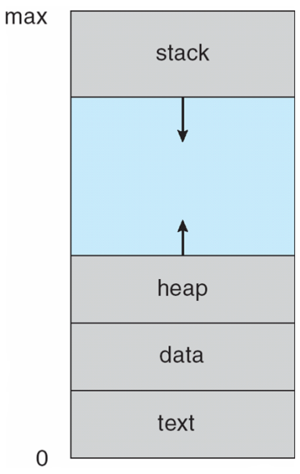
Process Concept
Process – a program in execution; process execution must progress in sequential fashion.
Textbook uses the terms job and process almost interchangeably.
A process includes:
  Program counter
  Stack (local variables)
  Data section (global data)
  Text (code)
  Heap (dynamic data)
  Files (cin, cout, cerr, other file descriptors)

Slide 3
Process State
As a process executes, it changes state
  new: The process is being created
  running: Instructions are being executed
  waiting: The process is waiting for some event to occur
  ready: The process is waiting to be assigned to a processor
  terminated: The process has finished execution

Slide 4

Process State

Slide 5

Process Control Block (PCB)
Information associated with each process
(also called task control block)
Process state – running, waiting, etc
Program counter – location of instruction to next execute
CPU registers – contents of all process-centric registers
CPU scheduling information- priorities, scheduling queue pointers
Memory-management information – memory allocated to the process
Accounting information – CPU used, clock time elapsed since start, time limits
I/O status information – I/O devices allocated to process, list of open files

Slide 6

Context Switch

Slide 7

Process Scheduling Queues

Slide 8
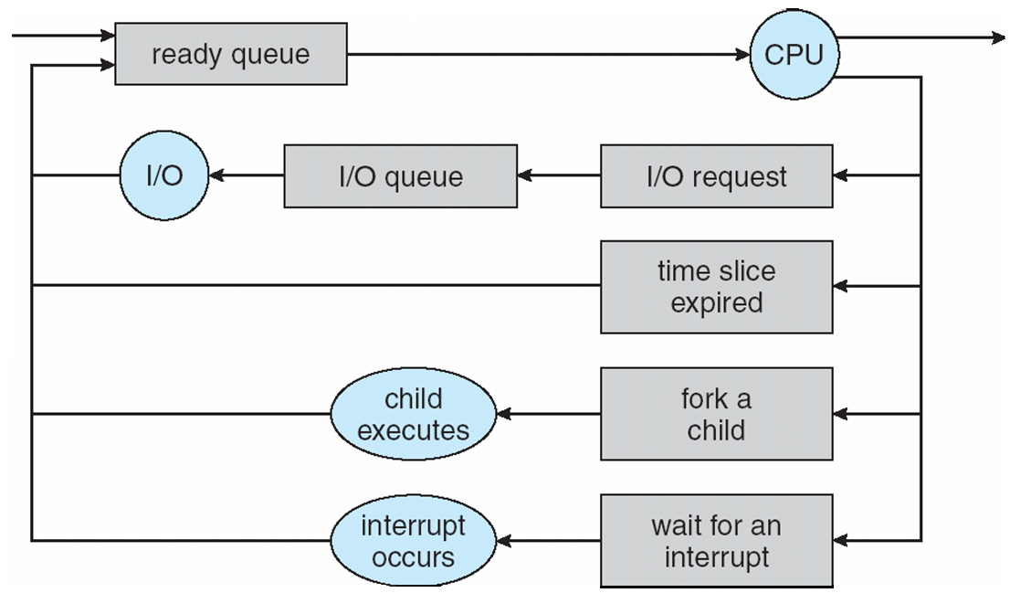
Representation of Process Scheduling
Short-term scheduler: picks up a process from
ready queue every 100ms
Long-term scheduler: swaps I/O waiting processes
in and out of memory

Slide 9
CPU Switch From Process to Process

Slide 10
Process Creation
Parent process creates children processes.
Resource sharing
  Resource inherited by children: file descriptors, shared memory and system queues
  Resource not inherited by children: address space
Execution
  Parent and children execute concurrently.
  Parent waits by wait system call until children terminate.
UNIX examples
  fork system call creates new process.
  execlp system call used after a fork to replace the process’ memory space with a new program.

Slide 11
C Program Forking Separate Process
#include <stdio.h>
#include <unistd.h>
int main(int argc, char *argv[])
{
int pid;
/* fork another process */
pid = fork();
if (pid < 0) { /* error occurred */
fprintf(stderr, "Fork Failed");
exit(-1);
}
else if (pid == 0) { /* child process */
execlp("/bin/ls","ls",NULL);
}
else { /* parent process */
/* parent will wait for the child to complete */
wait(NULL);
printf("Child Complete");
exit(0);
}
}
parent
a.out
child
duplicated
a.out
ls
synchronized

Slide 12
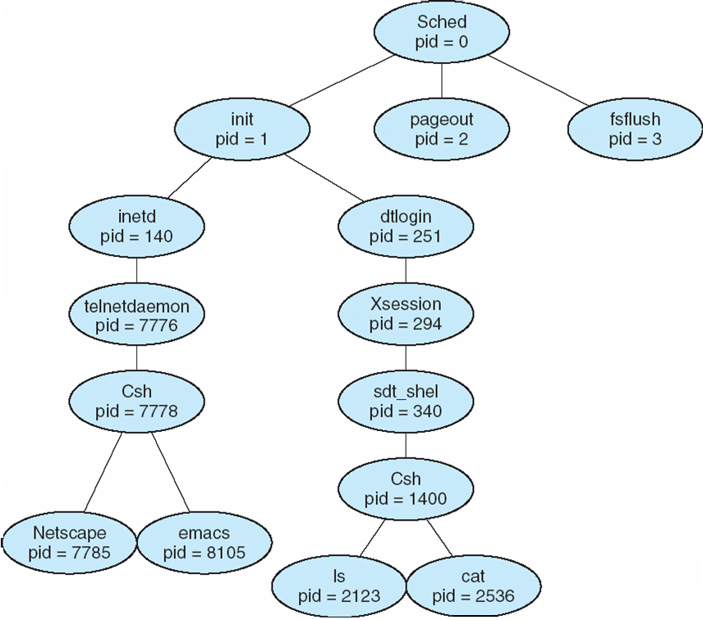
A Tree of Processes On A Typical Solaris

Slide 13
Process Termination
Process termination occurs when
  It executes the last statement
  It executes exit system call explicitly
Upon process termination
  Termination code is passed from child (via exit) to parent (via wait).
  Process’ resources are deallocated by OS.
Parent may terminate execution of children processes (via kill) when
  Child has exceeded allocated resources.
  Task assigned to child is no longer required.
  Parent is exiting (cascading termination).
    Some operating system does not allow child to continue if its parent terminates.
Orphan: parent terminated before child and then child is adopted by init
Zombie: child terminated before parent’s wait() and then a zombie waiting for the wait() to disapear

Slide 14
Discussions 1
List tasks required for process creation and termination in a chronological order.
Process 0 in Linux is the ancestor of all processes. Consider tasks performed by Process 0.
Upon exit( ), a child process remains as a zombie process that passes an exit code back to its parent. From a Linux shell, you can start a process with & and thus keep it running even after the logoff. What happened to this process?
The child process inherits most computing resources from its parent process. Why is it a natural idea? How can this inheritance be implemented inside the operating system?
There are two tasks with specially distinguished process IDs: swapper or sched has process ID 0 and is responsible for paging, and is actually part of the kernel rather than a normal user-mode process. Process ID 1 is usually the init process primarily responsible for starting and shutting down the system. Originally, process ID 1 was not specifically reserved for init by any technical measures: it simply had this ID as a natural consequence of being the first process invoked by the kernel. More recent Unix systems typically have additional kernel components visible as 'processes', in which case PID 1 is actively reserved for the init process to maintain consistency with older systems.

Slide 15
Cooperating Processes
Process independency: Processes belonging to a different user does not affect each other unless they give each other some access permissions
Process Cooperation: Processes spawned from the same user process share some resources and communicate with each other through them (e.g., shared memory, message queues, pipes, and files)
Advantages of process cooperation
  Information sharing: (sharing files)
  Computation speed-up: (parallel programming)
  Modularity: (like who | wc –l, one process lists current users and another counts the number of users.)
  Convenience: (net-surfing while working on programming with emacs and g++)

Slide 16

Communication Models
Message passing
Shared memory

Slide 17
Shared Memory
Bounded Buffer
Communication link or media has a bounded space to buffer in-transfer data.
import java.util.*;
public class BoundedBuffer
{
public BoundedBuffer( ) {
count = 0;
in = 0;
out = 0;
buffer = new Object[BUFFER_SIZE];
}
public void enter( Object item ) { }
public Object remove( ) { }
public static final int BUFFER_SIZE = 5;
private int count; // #items in buffer
private int in; // points to the next free position
private int out; // points to the next full position
private Object[] buffer; // a reference to buffer
}

Slide 18
Producer and Consumer Processes
Producer Process
for(int i = 0; ; i++ ) {
BoundedBuffer.enter(new Integer(i));
}
public void enter( Object item ) {
while ( count == BUFFER_SIZE )
; // buffer is full! Wait till buffer is consumed
++count;
buffer[in] = item; // add an item
in = ( in + 1 ) % BUFFER_SIZE;
}
public object remove( ) {
Object item;
while ( count == 0 )
; // buffer is empty! Wait till buffer is filled
-- count;
item = buffer[out]; // pick up an item
out = ( out + 1 ) % BUFFER_SIZE;
}
Buffer[0] [1] [2] [3] [4]
Consumer Process
for(int i = 0; ; i++ ) {
BoundedBuffer.remove( );
}
out
in

Slide 19
Message Passing
Message system – processes communicate with each other without resorting to shared variables.
IPC facility provides two operations:
  send(message) – message size fixed or variable
  receive(message)
If P and Q wish to communicate, they need to:
  establish a communication link between them
  exchange messages via send/receive
Implementation of communication link
  physical (e.g., shared memory, hardware bus)
  logical (e.g., logical properties)

Slide 20
Direct Communication
Processes must name each other explicitly:
  send (P, message) – send a message to process P
  receive(Q, message) – receive a message from process Q
How can a process locate its partner to communicate with?
  Processes are created and terminated dynamically and thus a partner process may have gone.
  Direct communication takes place between a parent and its child process in many cases.
    Example: pipe

Slide 21
Producer-Consumer Problems
who | wc -l
who
pipe
wc -l
mfukuda tty1 Apr 1 14:14
stiber tty2 Apr 2 15:19
ksung tty3 Apr 2 15:30
Output:
3
Producer process:
  who produces a list of current users.
Consumer process
  wc receives it for counting #users.
Communication link:
  OS provides a pipe.

Slide 22
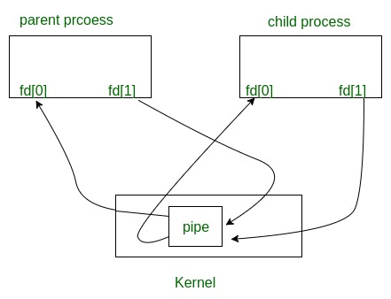

Slide 23
Direct Communication Example: Pipe
int main( void ) {
int n, fd[2];
int pid;
char line[MAXLINE];
if (pipe(fd) < 0 ) // 1: pipe created
perror( “pipe error” );
else if ( (pid = fork( ) ) < 0 ) // 2: child forked
perror( “fork error” );
else if ( pid > 0 ) { // parent
close( fd[0] ); // 3: parent’s fd[0] closed
write( fd[1], “hello world\n”, 12 );
} else { // child
close( fd[1] ); // 4: child’s fd[1] closed
n = read( fd[0], line, MAXLINE );
write( 1, line, n );
}
exit( 0 );
}
parent
2
child
fd[0], fd[1]
fd[0], fd[1]
3
1
4
pipe

Slide 24
Indirect Communication
Messages are directed and received from mailboxes (also referred to as ports).
  Each mailbox has a unique id.
  Processes can communicate only if they share a mailbox.
Processes must know only a mailbox id. They do not need to locate their partners
  Example: message queue

Slide 25
Indirect Communication
Example: Message Queues
struct mymesg {
long mytype;
char mtext[512];
} message_body;
int main( void ) {
int msgid = msgget( 100, IPC_CREAT );
strcpy( message_body.mtext, “hello world\n” );
msgsnd( msgid, &message_body, 512, 0 );
}
struct mymesg {
long mytype;
char mtext[512];
} message_body;
int main( void ) {
int msgid = msgget( 100, IPC_CREAT );
msgrcv( msgid, &message_body, 512, 0, 0 );
cout << message_body.mtext << endl;
}
Message queue
(id = msgid)
0
1
2
Some other process can
enqueue and dequeue a message
Notes:
msgget - get a System V message queue identifier
int msgsnd(int msqid, const void *msgp, size_t msgsz, int msgflg);
ssize_t msgrcv(int msqid, void *msgp, size_t msgsz, long msgtyp,
int msgflg);
Msgrcv:
The argument msgtyp specifies the type of message requested as follows:
*
If msgtyp is 0, then the first message in the queue is read.
*
If msgtyp is greater than 0, then the first message in the queue of type msgtyp is read, unless MSG_EXCEPT was specified in msgflg, in which case the first message in the queue of type not equal to msgtyp will be read.
*
If msgtyp is less than 0, then the first message in the queue with the lowest type less than or equal to the absolute value of msgtyp will be read.

Slide 26
Buffering
Queue of messages attached to the link; implemented in one of three ways.
  1. Zero capacity – 0 messages
  Sender must wait for receiver (rendezvous).
  2. Bounded capacity – finite length of n messages
  Sender must wait if link is full (This happens in practical world like sockets).
  3. Unbounded capacity – infinite length
  Sender never waits. (Non-blocking send)

Slide 27
Exercises (No turn-in)
In Unix, the first process is called init. All the others are descendants of “init”. The init process spawns a telnetd process that detects a new telnet connection. Upon a new connection, telnetd spawns a login process that then overloads a shell on it when a user successfully log in the system. Now, assume that the user types who | grep mfukuda | wc –l. Draw a process tree from init to those three commands. Add fork, exec, wait, and pipe system calls between any two processes affecting each other.
Consider four different types of inter-process communication.
  Pipe: implemented with pipe, read, and write
  Socket: implemented with socket, read, and write
  Shared memory: implemented shmget, shmat, and memory read/write
  Shared message queue: implemented with msgget, msgsnd, and msgrcv
  Which types are based on direct communication?
  Which types of communication do not require parent/child process relationship?
  If we code a produce/consumer program, which types of communication require us to implement process synchronization?
  Which types of communication can be used to communicate with a process running on a remote computers?
  Which types of communication must use file descriptors?
  Which types of communication need a specific data structure when transferring data?
Notes:
Posix : uses shared memory method.
Mach : uses message passing
Windows XP : uses message passing using local procedural calls
a) D b) D c) I d) I

